Slide 1
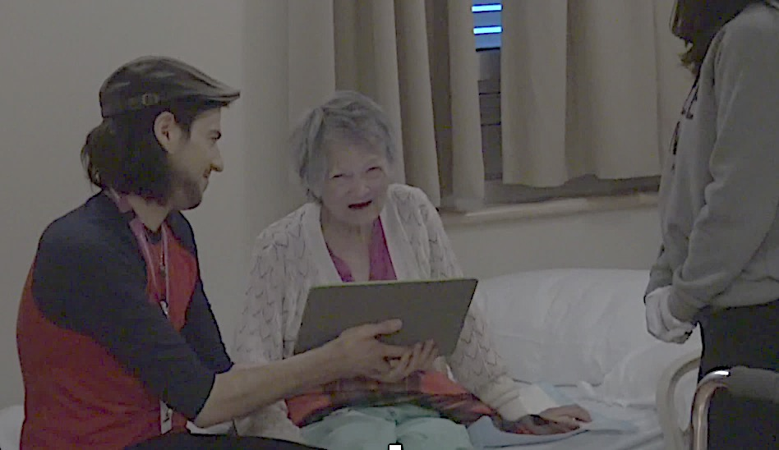
Using an iPad with family videos in Dementia Care
Lillian Hung RN PhD
Clinical Nurse Specialist

Slide 2
Why this research is important?
WorkSafe BC indicated that healthcare is a high risk industry
59% of the injuries are related to patient handling and violence
Our pilot study has shown using technology - an iPad as a non-pharmacological intervention has potential to promote safety and quality of care

Slide 3
How – use iPad to play a family video
Notes:
Meet Helen, not a real name. Helen has dementia and she does not know us. When a nurse approaches her to provide care, Helen would push the nurses away. We asked her family to self-record a one min. video and email to us. In the video, the daughter say” Hey mom, The nurses are here to help you. Take your pills now, I’ll come see you later.” We upload the video to our iPad, show it to the patient before care. Watch the video, pay attention to her facial expression. The movie is silenced to protect family’s voice.

Slide 4
Why - a simple and practical solution
Notes:
Another video, the same patient, Helen. The daughter asks her mom to let nurses help her get dressed. Play video.
You see, Helen not only became agreeable, she engaged and participated in care by taking her clothes off. This is so much better than holding the patients down and trying to take their clothes off. So, we believe there r 3 potentials with the idea of using the ipad with family video.
1. It promotes the patient safety, the family video helps the patient feel safe
2. It prevents staff injuries
3. It improves Q o Care, when families are enabled to be partners in care.

Slide 5
Settings and Participants
Older adult mental health at VGH
Geriatric medical units at Richmond Hospital
Patients with dementia, their families, staff and leaders in the team
Knowledge users are involved to co-design the research, co-analyze the results, co-create a toolkit for knowledge dissemination
Notes:
We propose to expand the study and focus on knowledge mobilization.

Slide 6
Research Question
What are the enablers and barriers to using an iPad to play family videos with patients with dementia in the hospital setting?
Notes:
We want to understand the contextual factors and the process for effective implementation.

Slide 7
Data Generation & Analysis
Video analysis
Staff interviews
Team analysis

Slide 8
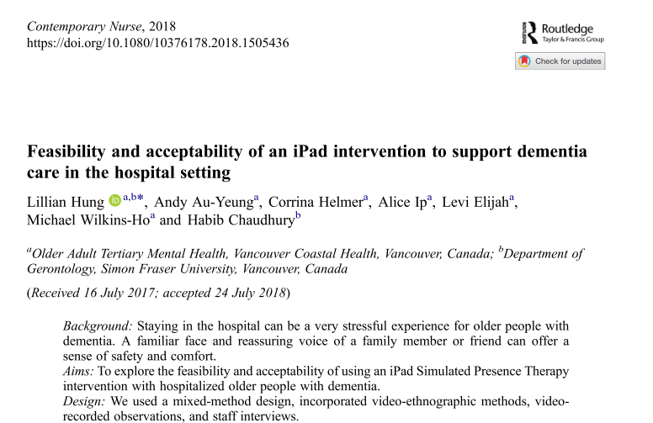
Moving research to Practice
KT activities are embedded in all stages of research
Knowledge users involvement will help understand what works
Toolkit :
Pocket card
Family brochure
Website
Notes:
Our findings published

